Slide 1
Private Equity on the Blockchain
Team 3
Mostafa Joma
Devin Nigro
Pedro Nunes
Andrea Ovelar
Peter Repetto
Brody Wacker
Notes:
Andrea

Slide 2
Motivation
Generate a platform that can allow any investor the participation on Private Equity funds that tend to be illiquid and offered to a selected few. Funds will be raised through a crowdsale and then traded in the secondary market with a lock-in period of 10 years.
Notes:
Andrea

Slide 3
Project Overview
Private Equity funds can now raise funds through the creation of their own security token offering (STO)
Market creation after the funds are raise is generated for investors to sell and buy their coins in the fund
Notes:
ANDREA

Slide 4



Tokenizing Private Equity Fund
Advantages
Access to Global Markets
Automated Servicing
ERC Compliance Enforcement
Ease of Asset Transferability
Notes:
MOSTAFA

Slide 5



Tokenizing Private Equity Fund
Advantages will provide to investors:
Digital shares.
Greater liquidity
24/7 Market
Cost effective
Rapid settlement
Quickly assess positions
Notes:
MOSTAFA

Slide 6
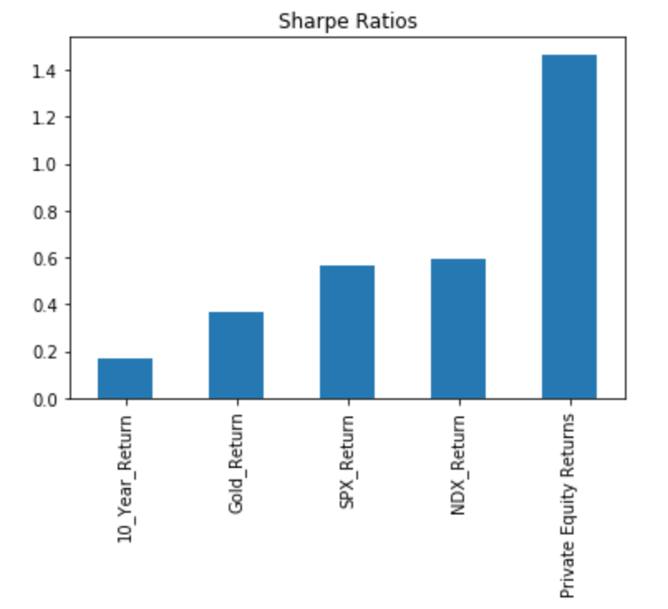
What Is The Differentiating factor?
Why Private Equity?
Based on historical analysis Private Equity Firms have been able to deliver higher returns with less volatility
Hence, Private Equity firms exhibit a higher sharpe ratio when compared to other global assets
Notes:
PETER

Slide 7
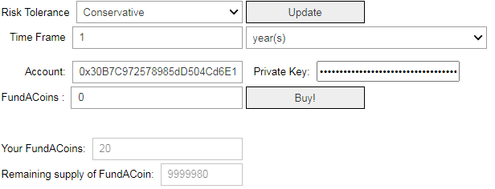





Application 1: Fundraising via crowdsale
Dashboard Example
Remix IDE (Solidity)
openzepellin
Python
Infura
Tested on Kovan network
Metamask
Exchange rate converter
Picture with Dashboard
Notes:
DEVIN

Slide 8
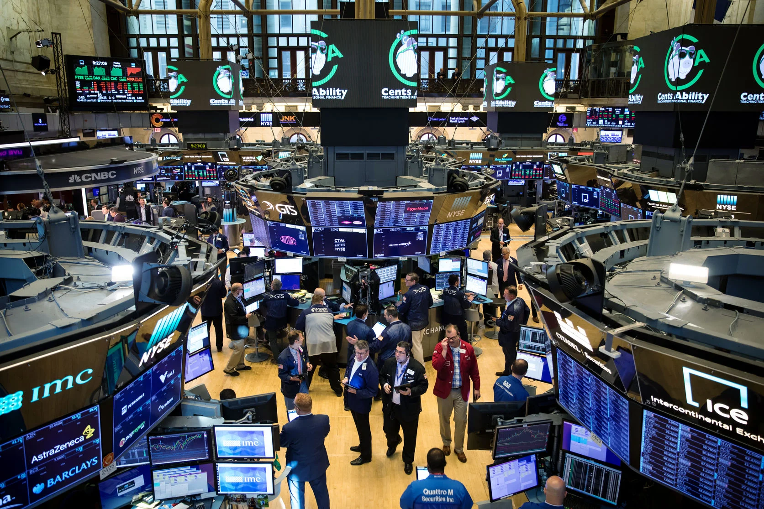
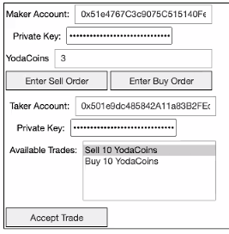

Application 2: Secondary market trading
Notes:
BRODY

